Slide 1
Pediatric Restraints
A review of commercial available products for the transport of children by emergency ground ambulance.

Slide 2
Overview of FMVSS specific to Emergency Ground Ambulances
National Highway Traffic Safety Administration (NHSTA) has two Federal Motor Vehicle Safety Standards (FMVSS) for child safety restraints as defined in FMVSS 208 and FMVSS 213, which set the standards for use of child restraint systems in passenger cars and light trucks manufactured after September 2004. These specifications define a child restraint in a forward and rear facing orientation.
Currently there are no federal standards for transport of children in emergency ground ambulances.
Manufacturers of child restraint systems are self certifying to FMVSS 208 and FMVSS 213 standards. NHTSA does not approve or certify any child restraint system.

Slide 3
Pediatric Restraints
The draft recommendations for the safe transportation of children in emergency ground ambulances are organized into five categories reflecting common situations:
Child who is uninjured / not ill
Child who is ill and/or injured and whose condition does not require continuous and/or intensive medical monitoring and/or interventions
Child whose condition requires continuous and/or intensive medical monitoring and/or interventions
Child whose condition requires spinal immobilization and/or lying flat
Child or children who require transport as part of a multiple patient transport (newborn with Mother, multiple children)
Reference: NHSTA-2010-0089

Slide 4
Standard Pediatric Sizing Definition
Infant 0 – 20 Pounds
Toddler 20 – 40 Pounds
Child 40 – 100 Pounds

Slide 5
Child Who is Uninjured/Not Ill
For safe restraint of the uninjured child there are a wide range of options available in the retail market of traditional child car seats
Specialized solutions especially designed for EMS include integrated captain chair/child seat (EVS, Ltd. & Serenity)or specialized rapid deployment seats (Ferno).

Slide 6
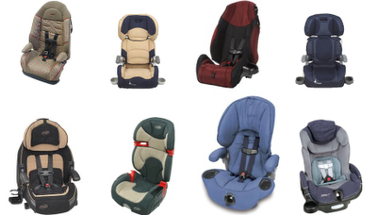
Commercial Child Seats
Pros:
Inexpensive to acquire
Good for 4-40 lbs children
Meets FMVSS 213
Cons:
Difficult to store on ambulance
Not intended by manufacturer for use on cot
Difficult to clean
Is not easily adjustable to child size

Slide 7
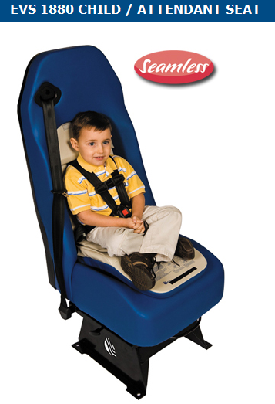
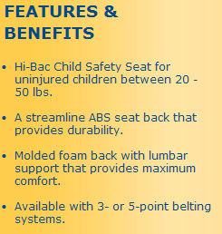
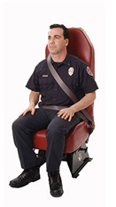
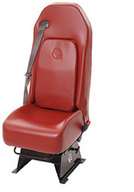
EVS, Ltd.
Pros:
Integrated into the seat
Self stowing
Meets applicable FMVSS standards
Cons:
Not infant compatible
Only for new ambulance construction

Slide 8
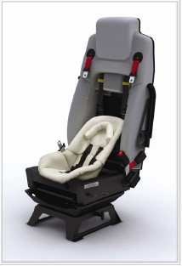
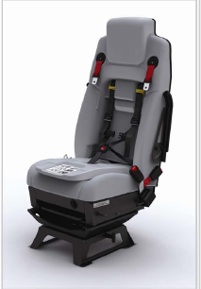
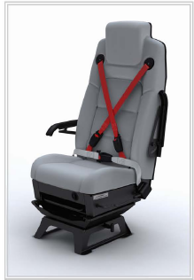
Pros:
Integrated into the seat
Easy to store
Meets all applicable FMVSS standards
Cons:
Expensive
Only for new ambulance construction
Difficult to clean

Slide 9
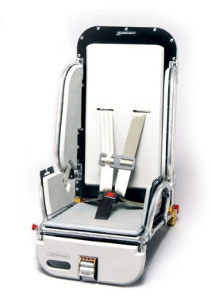
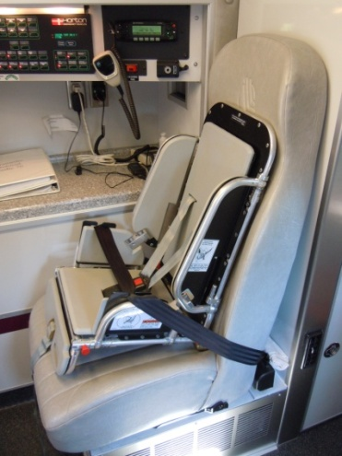
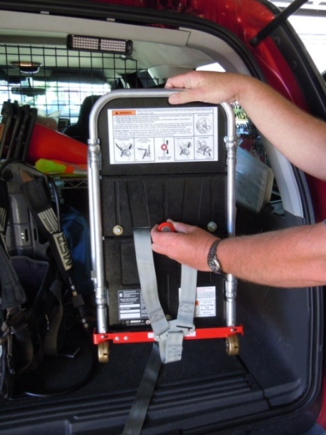
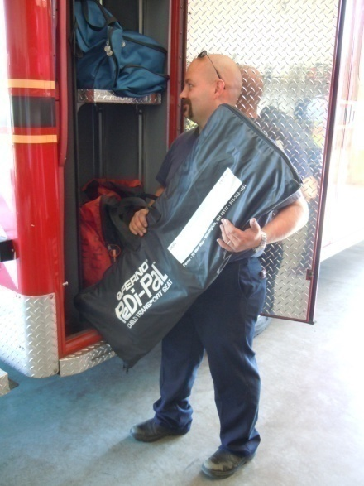
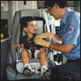
Pedi-Pal® Child Transport Seat
by
Pros:
Stores flat in ambulance compartment
Easy to adjust for all size children
Easy to clean
Meets all applicable FMVSS standards
Use in standard seats and on cot
Cons:
Price
Does not immobilize

Slide 10
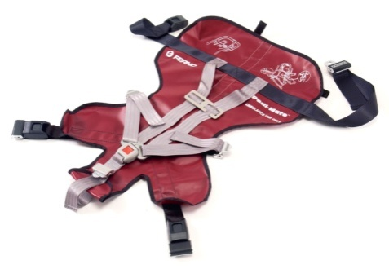
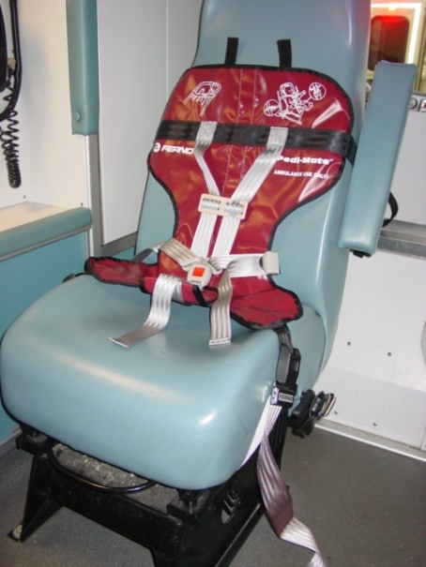
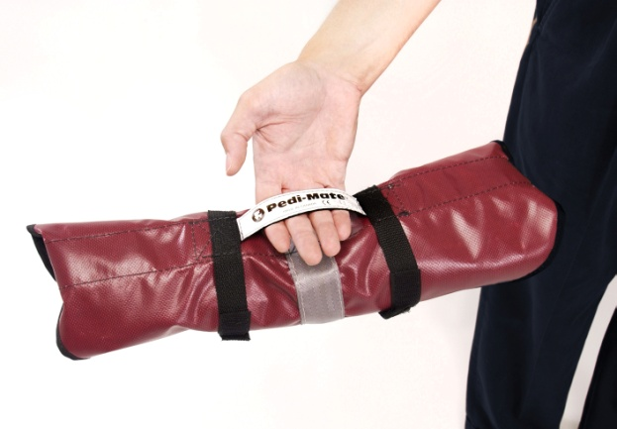
Pedi-Mate™ EMS Child Restraint by Ferno
Pros:
Lightweight and easy to store
Quick to deploy and apply to child
Meets all applicable FMVSS standards
Cons:
Does not immobilize the child

Slide 11
Child who is Ill and/or injured and whose condition does not require continuous and/or intensive medical monitoring and/or interventions

Slide 12
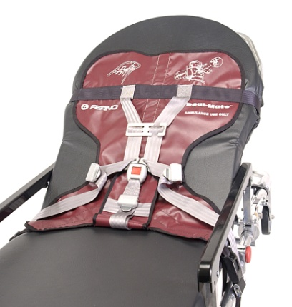
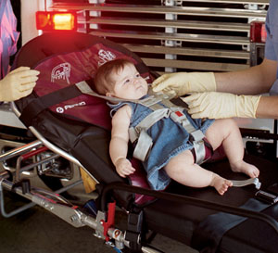
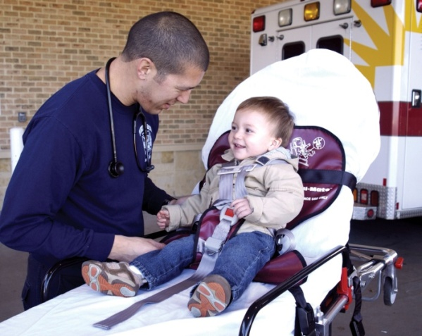
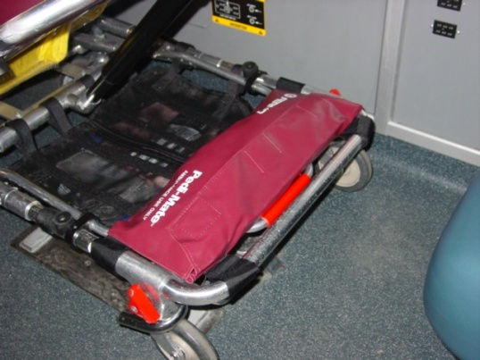
Pedi-Mate™ EMS Child Restraint by Ferno
Pros:
Easy to store on cot or in cabinet
Safe restraint while not immobilizing
Cons:
Only accommodates
children up to 40 pounds

Slide 13
Pedi-Pal® Child Transport Seat
by
Pros:
Stores flat in ambulance compartment
Easy to adjust for all size children
Easy to clean
Meets all applicable FMVSS standards
Use in standard seats and on cot
Cons:
Price
Does not immobilize

Slide 14
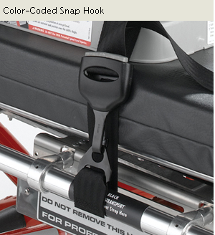
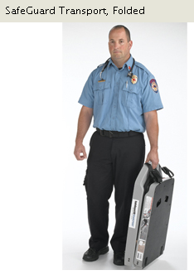
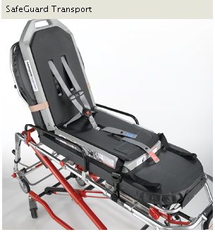
SafeGuard Transport
by IMMI®
Pros:
Adjustable for a wide range of children
Crash tested
Adjustable backrest
Cons:
Only be used on a cot
Expensive
Storage and weight

Slide 15
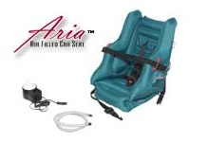
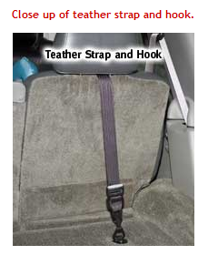
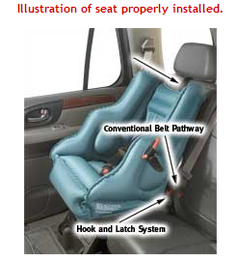
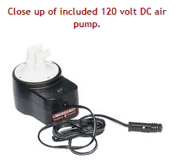
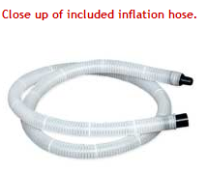
Aria™ Air Filled Child Transport Seat
by EP& R
Pros:
Easy to store
Lightweight
Cons:
Not infant compatible
Can puncture
Electric requirement

Slide 16
Child whose condition requires continuous and/or intensive medical monitoring and/or interventions
Note: Devices in this section are primarily medical devices and secondarily compliant to FMVSS standards.

Slide 17
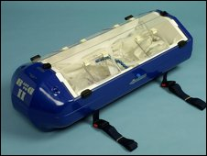
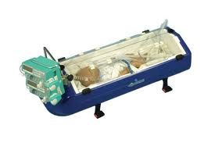
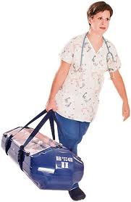
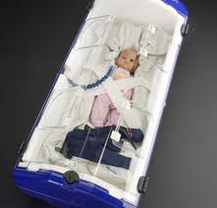
BabyPod™ Pediatric Transporter by Ferno
Pros:
Lightweight & easy to transport
Designed for use on cot
Cons:
Storage
Price

Slide 18
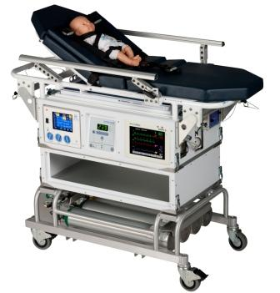
Pedi-Porter by International Biomedical
Pros:
Removable stretcher for complete range of children
Integrated medical system
Cons:
Price
Not crash tested
Only accommodates children up to
50 pounds
Difficult to load in ambulance

Slide 19
Child whose condition requires spinal immobilization and/or lying flat
Note: Devices in this section are primarily medical devices and secondarily compliant to FMVSS standards.

Slide 20
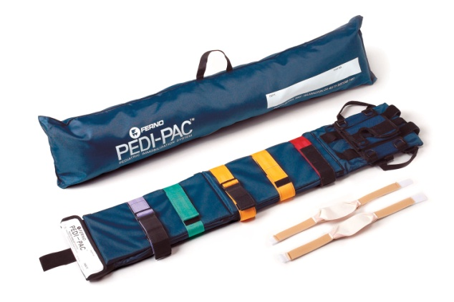
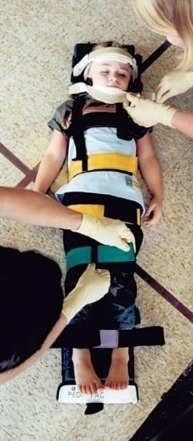
Pedi-Pac™ by Ferno
Pros:
Easy to clean & store in BB compartment
Adjustable for any size child with complete immobilization
Color coded straps for easy application
Cons:
Only supine position
Does not accommodate infants

Slide 21
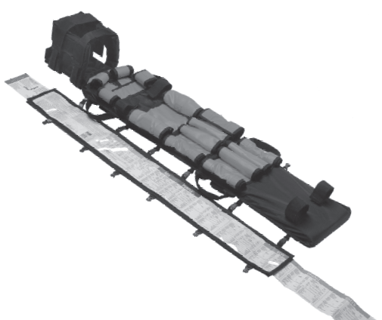
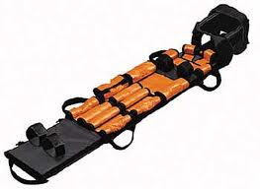
LSP Infant/Pediatric Immobilization Board
By Allied Healthcare
Pros:
Braslow tape available as option
Cons:
Not adjustable to child sizes
No color coded restraints
Board not removable for cleaning

Slide 22
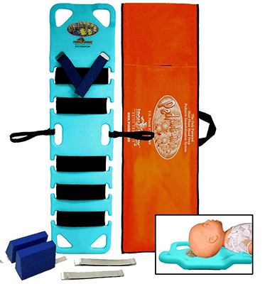
Pedi Air Align
by Iron Duck
Pros:
Easy to clean
Lightweight
Cons:
Not adjustable occipital alignment
Fixed restraint positions

Slide 23
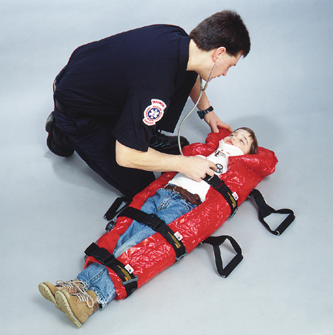
Pediatric Vacuum Mattress by MDI
Pros:
Full immobilization
Lightweight and easy to clean
Cons:
Difficult to store
Easy to puncture vacuum seal

Slide 24
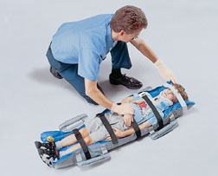
Pediatric Evac-U-Splint® by Hartwell
Pros:
Full immobilization
Lightweight and easy to clean
Cons:
Difficult to store
Easy to puncture vacuum seal

Slide 25
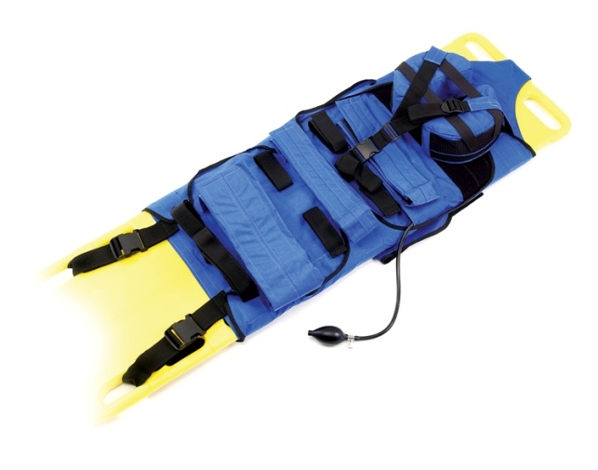
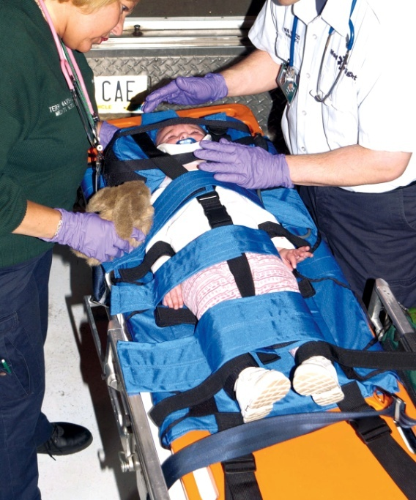
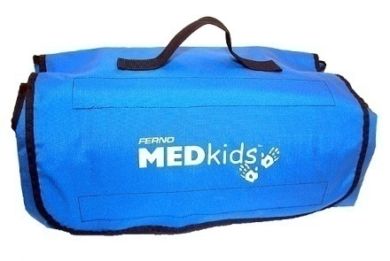
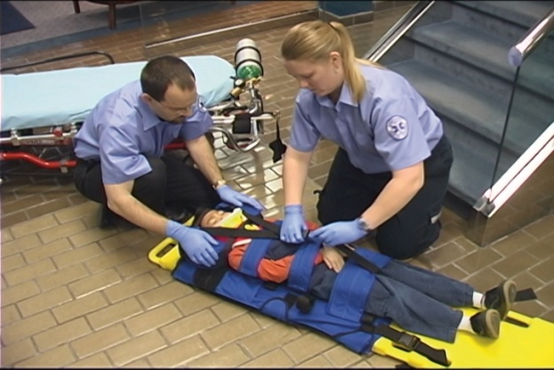
MEDkids™ Backboard Immobilization Restraint by Ferno
Pros:
Fits over any backboard
Air alignment feature with inflatable cuff
Easy to store in ambulance and cleanable
Fits full range of children up to 80 lbs.
Cons:
Only supine position

Slide 26
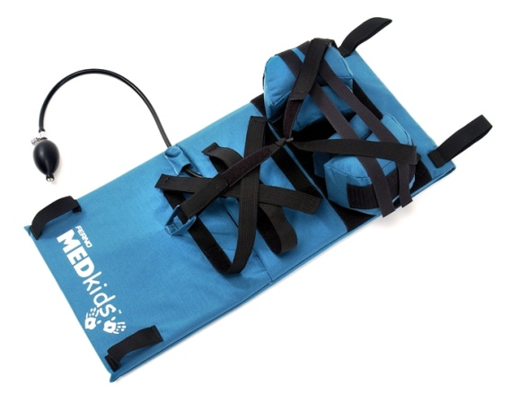
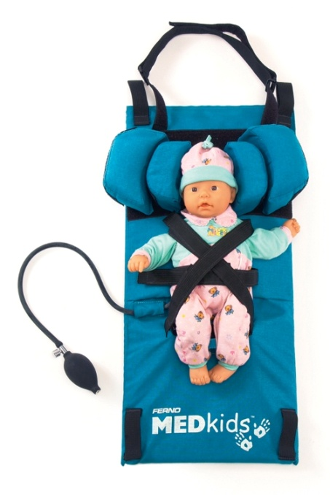
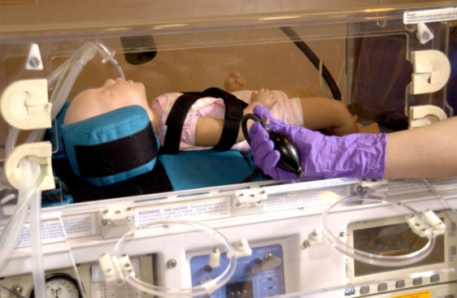
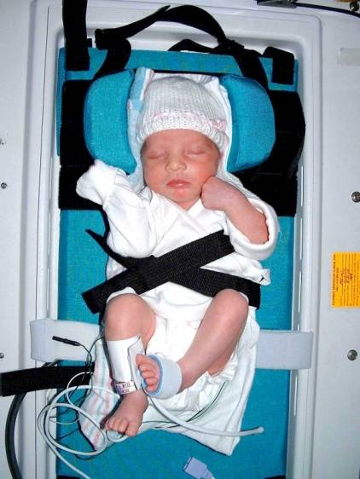
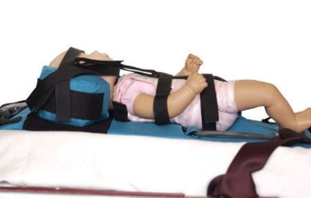
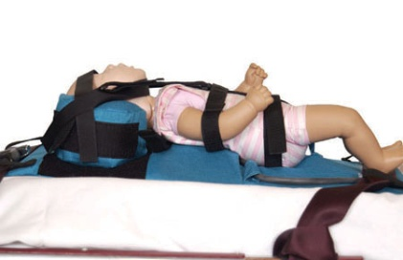
MEDkids™ Baby Board by Ferno
Pros:
Fits in incubator or on cot
Only immobilization device for babies less than ten pounds
Easy to store and wash
Air alignment feature
Cons:
Specialized transport only

Slide 27
Child or children who require transport as part of a multiple patient transport (newborn with mother, multiple children)

Slide 28
Commercial Child Seats
Pros:
Inexpensive to acquire
Good for 4-40 lbs children
Meets FMVSS 213
Cons:
Difficult to store on ambulance
Not usable on cot
Difficult to clean
Is not easily adjustable to child size

Slide 29
Pedi-Mate EMS Child Restraint by Ferno
Pros:
Usable in any application
Easy to clean & store on cot or in ambulance
Cons:
No immobilization

Slide 30
Pedi-Pal® Child Transport Seat
by
Pros:
Stores flat in ambulance compartment
Easy to adjust for all size children
Easy to clean
Meets all applicable FMVSS standards
Use in standard seats and on cot
Cons:
Price
Does not immobilize

Slide 31
Aria™ Air Filled Child Transport Seat
by EP& R
Pros:
Easy to store
Lightweight
Cons:
Not infant compatible
Can puncture
Electric requirement

Slide 32
Pediatric Product Comparison for Emergency Ground Ambulances 1 August - 2010 Sorted by Manufacturer
Manufacturer |  | Device Name | Product Weight | Child Size | Immobilization Capable | Infant Compatible | Installation Compatibility (Cot/Captains Chair) | Cleanability |  | Price | Federal Regulation Compliancy | Comments
Allied Healthcare |  | LSP Pediatric Immobilizer | 6 lbs | 20-65 lbs | Yes | Yes | Cot | Machine Washable |  | Medium | FDA Class 2 | Immobilzation Focus
EP&R, Inc. |  | Arie-Air ™ Filled Transport Seat | 18 lbs | 20-40 lbs | No | No | Cot/Captains Chair | Wipe Clean |  | Medium | FMVSS 213 | Not For Infants
EVS |  | 1800 Child/Attendant Seat | N/A | 20-50 lbs | No | No | Captains Chair | Wipe Clean |  | Medium | FMVSS 213 | Install At Ambulance Construction
Ferno |  | Pedi Mate ® Restraint System | 3 lbs | 2-40 lbs | No | Yes | Cot/Captains Chair | Wipe Clean |  | Low | FMVSS 213 | Very Flexible Use
Ferno |  | Pedi Pal ® Child Transport Seat | 16 lbs | 10-40 lbs | No | Yes | Cot/Captains Chair | Wipe Clean |  | High | FMVSS 213/208 | Car Seat Equivalent
Ferno |  | MEDkids Baby Board ® | 6 lbs | 2-20 lbs | Yes | Yes | Cot | Machine Washable |  | Low | FDA Class 2A | Incubator Transporter Use
Ferno |  | MEDkids Pedi-Sleeve ® | 3lbs | 18-60 lbs | Yes | No | Cot | Machine Washable |  | Low | FDA Class 2A | Requires Backboard
Ferno |  | Baby Pod ® Infant Transport System | 20 lbs | 2-20 lbs | No | Yes | Cot | Wipe Clean |  | Low | FDA Class 2 | Specialized Care - Incubator
Ferno |  | Pedi-Pac ® Spine Immobilizer | 6 lbs | 20-90 lbs | Yes | No | Cot | Machine Washable |  | Medium | FDA Class 2 | Immobilzation Focus
Hartwell |  | Pediatric Vacuum Mattress | 8 lbs | 10-60 lbs | Yes | Yes | Cot | Wipe Clean |  | Medium | FDA Class 2 | Also Functions as Extremity Immobilization
IMMI |  | Safe Guard Transport ™ | 22 lbs | 22-100 lbs | No | No | Cot | Wipe Clean |  | High | FMVSS 213 | Difficult Storage
Intl. Biomedical |  | Pedi Porter | 250 lbs | 10-60 lbs | No | No | N/A | Wipe Clean |  | High | FDA Class 2 | Specialized Care - Intensive Care
Iron Duck |  | Pedi-Air-Align ® Board | 8 lbs | 10-20 lbs | Yes | No | Cot | Wipe Clean |  | Medium | FDA Class 2 | Immobilzation Focus
MDI |  | Pediatric Vacuum Mattress | 8 lbs | 10-60 lbs | Yes | Yes | Cot | Wipe Clean |  | Medium | FDA Class 2 | Also Functions as Extremity Immobilization
Serenity |  | Guardian ™ Safety Seat | N/A | 5-85 lbs | No | Yes | Captains Chair | Wipe Clean |  | High | FMVSS 213/208 | Install at Ambulance Construction
DEFINITIONS:
Price: Low - Under $200, Medium - $200-$400, High - Greater Than $400

Slide 33
Pediatric Product Comparison for Emergency Ground Ambulances 1 August - 2010 Sorted by NHSTA - 2010-0085 Recommended Standards
Manufacturer |  | Device Name | Product Weight | Child Size | Immobilization Capable | Infant Compatible | Installation Compatibility (Cot/Captains Chair) | Cleanability |  | Price | Federal Regulation Compliancy | Comments
Situation 1 / For a Child who is uninjured / not ill
EP&R, Inc. |  | Arie-Air ™ Filled Transport Seat | 18 lbs | 20-40 lbs | No | No | Cot/Captains Chair | Wipe Clean |  | Medium | FMVSS 213 | Not For Infants
EVS |  | 1800 Child/Attendant Seat | N/A | 20-50 lbs | No | No | Captains Chair | Wipe Clean |  | Medium | FMVSS 213 | Install At Ambulance Construction
Ferno |  | Pedi Mate ® Restraint System | 3 lbs | 2-40 lbs | No | Yes | Cot/Captains Chair | Wipe Clean |  | Low | FMVSS 213 | Very Flexible Use
Ferno |  | Pedi Pal ® Child Transport Seat | 16 lbs | 10-40 lbs | No | Yes | Cot/Captains Chair | Wipe Clean |  | High | FMVSS 213/208 | Car Seat Equivalent
Serenity |  | Guardian ™ Safety Seat | N/A | 5-85 lbs | No | Yes | Captains Chair | Wipe Clean |  | High | FMVSS 213/208 | Install at Ambulance Construction
Situation 2 / For a Child who is ill and/or injured and whose condition does not require continuous and/or intensive medical monitoring and/or interventions
EP&R, Inc. |  | Arie-Air ™ Filled Transport Seat | 18 lbs | 20-40 lbs | No | No | Cot/Captains Chair | Wipe Clean |  | Medium | FMVSS 213 | Not For Infants
Ferno |  | Pedi Mate ® Restraint System | 3 lbs | 2-40 lbs | No | Yes | Cot/Captains Chair | Wipe Clean |  | Low | FMVSS 213 | Very Flexible Use
Ferno |  | Pedi Pal ® Child Transport Seat | 16 lbs | 10-40 lbs | No | Yes | Cot/Captains Chair | Wipe Clean |  | High | FMVSS 213/208 | Car Seat Equivalent
IMMI |  | Safe Guard Transport ™ | 22 lbs | 22-100 lbs | No | No | Cot | Wipe Clean |  | High | FMVSS 213 | Difficult Storage
Situation 3 / For a Child whose condition requires continuous and/or intensive medical monitoring and/or interventions
Ferno |  | Pedi Mate ® Restraint System | 3 lbs | 2-40 lbs | No | Yes | Cot/Captains Chair | Wipe Clean |  | Low | FMVSS 213 | Very Flexible Use
Ferno |  | Pedi Pal ® Child Transport Seat | 16 lbs | 10-40 lbs | No | Yes | Cot/Captains Chair | Wipe Clean |  | High | FMVSS 213/208 | Car Seat Equivalent
Ferno |  | Baby Pod ® Infant Transport System | 20 lbs | 2-20 lbs | No | Yes | Cot | Wipe Clean |  | Low | FDA Class 2 | Specialized Care - Incubator
IMMI |  | Safe Guard Transport ™ | 22 lbs | 22-100 lbs | No | No | Cot | Wipe Clean |  | High | FMVSS 213 | Difficult Storage
Intl. Biomedical |  | Pedi Porter | 250 lbs | 10-60 lbs | No | No | N/A | Wipe Clean |  | High | FDA Class 2 | Specialized Care - Intensive Care
Situation 4 / For a Child whose condition requires spinal immobilization and/or lying flat
Allied Healthcare |  | LSP Pediatric Immobilizer | 6 lbs | 20-65 lbs | Yes | Yes | Cot | Machine Washable |  | Medium | FDA Class 2 | Immobilzation Focus
Ferno |  | MEDkids Baby Board ® | 6 lbs | 2-20 lbs | Yes | Yes | Cot | Machine Washable |  | Low | FDA Class 2A | Incubator Transporter Use
Ferno |  | MEDkids Pedi-Sleeve ® | 3lbs | 18-60 lbs | Yes | No | Cot | Machine Washable |  | Low | FDA Class 2A | Requires Backboard
Ferno |  | Pedi-Pac ® Spine Immobilizer | 6 lbs | 20-90 lbs | Yes | No | Cot | Machine Washable |  | Medium | FDA Class 2 | Immobilzation Focus
Hartwell |  | Pediatric Vacuum Mattress | 8 lbs | 10-60 lbs | Yes | Yes | Cot | Wipe Clean |  | Medium | FDA Class 2 | Also Functions as Extremity Immobilization
Iron Duck |  | Pedi-Air-Align ® Board | 8 lbs | 10-20 lbs | Yes | No | Cot | Wipe Clean |  | Medium | FDA Class 2 | Immobilzation Focus
MDI |  | Pediatric Vacuum Mattress | 8 lbs | 10-60 lbs | Yes | Yes | Cot | Wipe Clean |  | Medium | FDA Class 2 | Also Functions as Extremity Immobilization
Situation 5 / For a Child requiring transport as part of a multiple patient transport (newborn with Mother, multiple children, etc.)
EP&R, Inc. |  | Arie-Air ™ Filled Transport Seat | 18 lbs | 20-40 lbs | No | No | Cot/Captains Chair | Wipe Clean |  | Medium | FMVSS 213 | Not For Infants
EVS |  | 1800 Child/Attendant Seat | N/A | 20-50 lbs | No | No | Captains Chair | Wipe Clean |  | Medium | FMVSS 213 | Install At Ambulance Construction
Ferno |  | Pedi Mate ® Restraint System | 3 lbs | 2-40 lbs | No | Yes | Cot/Captains Chair | Wipe Clean |  | Low | FMVSS 213 | Very Flexible Use
Ferno |  | Pedi Pal ® Child Transport Seat | 16 lbs | 10-40 lbs | No | Yes | Cot/Captains Chair | Wipe Clean |  | High | FMVSS 213/208 | Car Seat Equivalent
Serenity |  | Guardian ™ Safety Seat | N/A | 5-85 lbs | No | Yes | Captains Chair | Wipe Clean |  | High | FMVSS 213/208 | Install at Ambulance Construction

Slide 34
Pediatric Product Comparison for Emergency Ground Ambulances 1 August - 2010 Sorted by Child Size
Manufacturer |  | Device Name | Product Weight | Child Size | Immobilization Capable | Infant Compatible | Installation Compatibility (Cot/Captains Chair) | Cleanability |  | Price | Federal Regulation Compliancy | Comments
Ferno |  | Pedi Mate ® Restraint System | 3 lbs | 2-40 lbs | No | Yes | Cot/Captains Chair | Wipe Clean |  | Low | FMVSS 213 | Very Flexible Use
Ferno |  | MEDkids Baby Board ® | 6 lbs | 2-20 lbs | Yes | Yes | Cot | Machine Washable |  | Low | FDA Class 2A | Incubator Transporter Use
Ferno |  | Baby Pod ® Infant Transport System | 20 lbs | 2-20 lbs | No | Yes | Cot | Wipe Clean |  | Low | FDA Class 2 | Specialized Care - Incubator
Serenity |  | Guardian ™ Safety Seat | N/A | 5-85 lbs | No | Yes | Captains Chair | Wipe Clean |  | High | FMVSS 213/208 | Install at Ambulance Construction
Iron Duck |  | Pedi-Air-Align ® Board | 8 lbs | 10-20 lbs | Yes | No | Cot | Wipe Clean |  | Medium | FDA Class 2 | Immobilzation Focus
Ferno |  | Pedi Pal ® Child Transport Seat | 16 lbs | 10-40 lbs | No | Yes | Cot/Captains Chair | Wipe Clean |  | High | FMVSS 213/208 | Car Seat Equivalent
Hartwell |  | Pediatric Vacuum Mattress | 8 lbs | 10-60 lbs | Yes | Yes | Cot | Wipe Clean |  | Medium | FDA Class 2 | Also Functions as Extremity Immobilization
Intl. Biomedical |  | Pedi Porter | 250 lbs | 10-60 lbs | No | No | N/A | Wipe Clean |  | High | FDA Class 2 | Specialized Care - Intensive Care
MDI |  | Pediatric Vacuum Mattress | 8 lbs | 10-60 lbs | Yes | Yes | Cot | Wipe Clean |  | Medium | FDA Class 2 | Also Functions as Extremity Immobilization
Ferno |  | MEDkids Pedi-Sleeve ® | 3lbs | 18-60 lbs | Yes | No | Cot | Machine Washable |  | Low | FDA Class 2A | Requires Backboard
EP&R, Inc. |  | Arie-Air ™ Filled Transport Seat | 18 lbs | 20-40 lbs | No | No | Cot/Captains Chair | Wipe Clean |  | Medium | FMVSS 213 | Not For Infants
EVS |  | 1800 Child/Attendant Seat | N/A | 20-50 lbs | No | No | Captains Chair | Wipe Clean |  | Medium | FMVSS 213 | Install At Ambulance Construction
Allied Healthcare |  | LSP Pediatric Immobilizer | 6 lbs | 20-65 lbs | Yes | Yes | Cot | Machine Washable |  | Medium | FDA Class 2 | Immobilzation Focus
Ferno |  | Pedi-Pac ® Spine Immobilizer | 6 lbs | 20-90 lbs | Yes | No | Cot | Machine Washable |  | Medium | FDA Class 2 | Immobilzation Focus
IMMI |  | Safe Guard Transport ™ | 22 lbs | 22-100 lbs | No | No | Cot | Wipe Clean |  | High | FMVSS 213 | Difficult Storage

Slide 35
Pediatric Restraints A review of commercial available products for the transport of children by emergency ground ambulance. The END !

